Slide 1
Stroke Prediction Using SVM, Decision Tree, and KNN

Slide 2
Business Usecase
Stroke is a critical medical condition where early detection plays an important role in improving patient recovery and survival rates. In this project, machine learning techniques are used to predict the likelihood of a patient experiencing a stroke based on different health-related factors.
The project mainly focuses on implementing and comparing three classification algorithms — Support Vector Machine (SVM), Decision Tree, and K-Nearest Neighbors (KNN) — to predict stroke occurrence. Their performance is evaluated using accuracy and other important evaluation metrics.

Slide 3
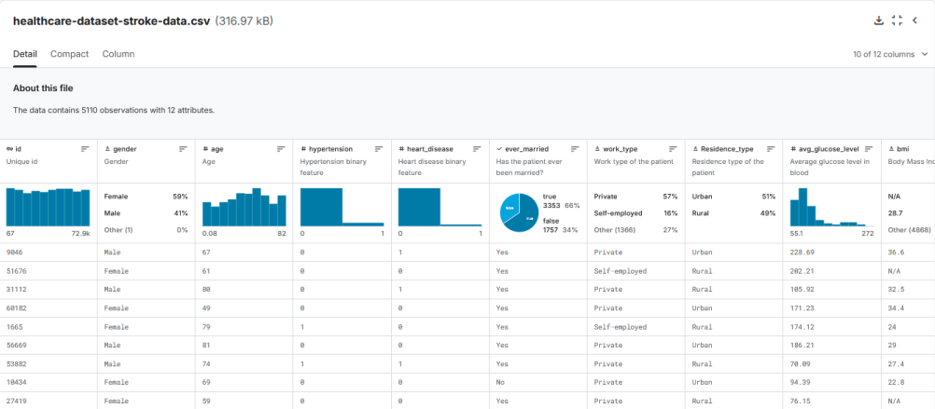
Dataset overview
The dataset used in this project is taken from Kaggle’s Stroke Prediction Dataset. It includes patient details such as age, gender, hypertension, and several other health-related attributes. The main objective is to classify patients into two groups: stroke and non-stroke.

Slide 4
Model selection
Support Vector Machine (SVM): SVM is chosen for its ability to handle high-dimensional data and non-linear relationships. It excels in finding the optimal separating hyperplane between different classes.
K-Nearest Neighbors (KNN): KNN is a non-parametric algorithm that uses proximity to classify data points. It's simple and works well when the relationship between data points is smooth and continuous.
Decision Tree: Decision Trees are chosen for their simplicity and interpretability. They make decisions by splitting the dataset based on feature values, forming a tree-like structure..

Slide 5
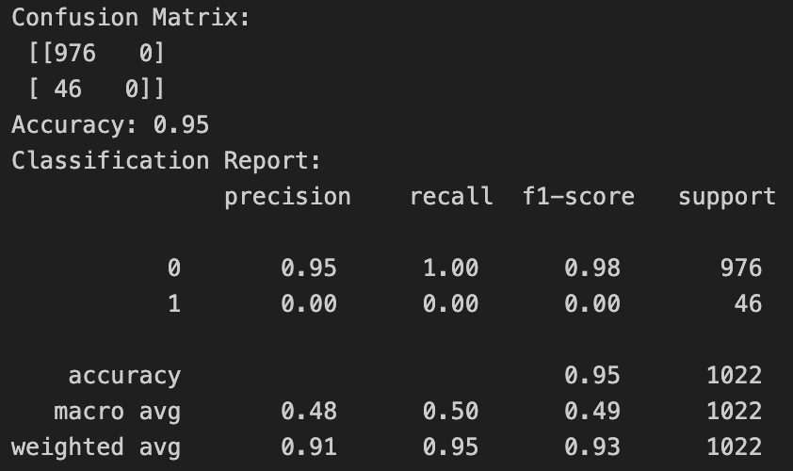
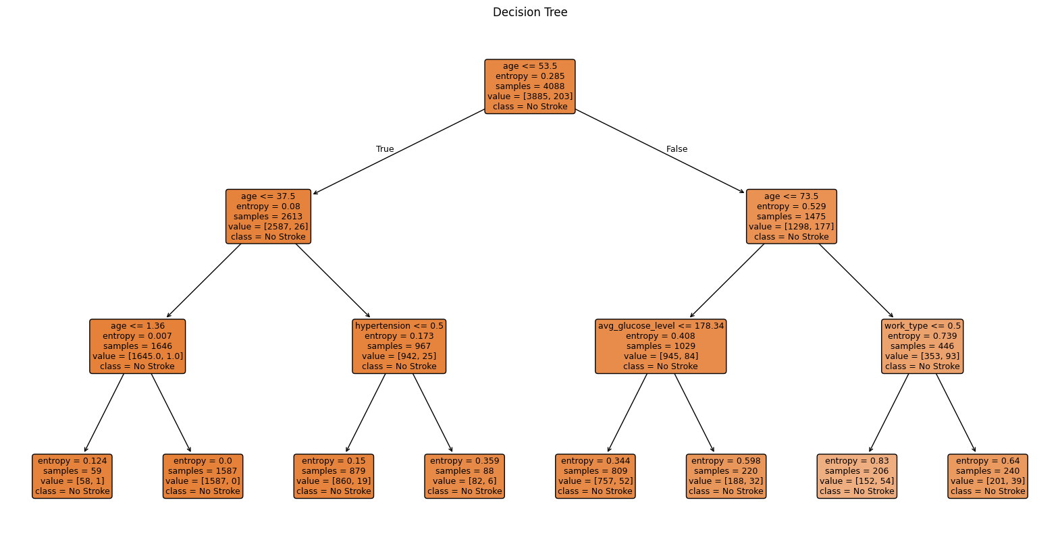
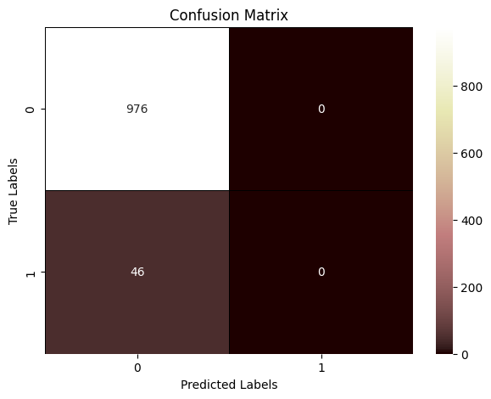
Decision tree:
The decision tree model had a strong accuracyrate but also did not predict stroke cases, suggesting it may have overfitted the training data.

Slide 6
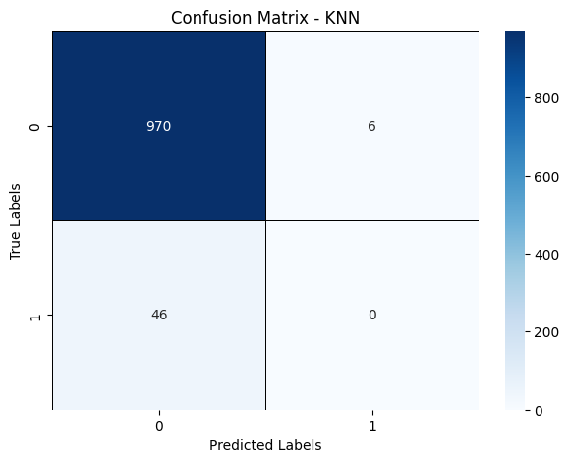
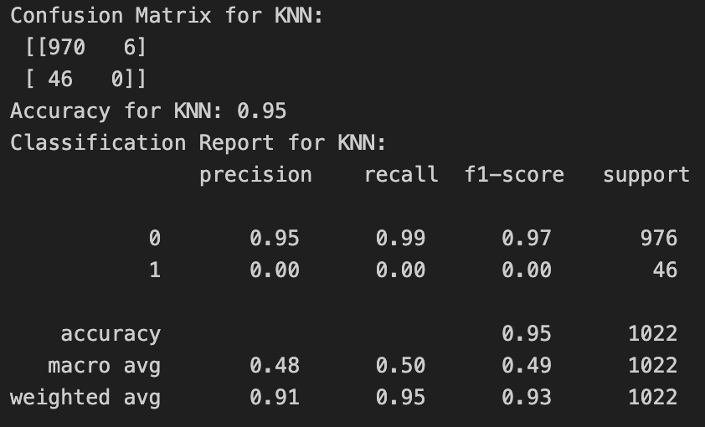
K-Nearest Neighbors (KNN):
Although KNN showed high accuracy, it failed to predict any stroke cases, indicating a lack of sensitivity to this critical class.

Slide 7
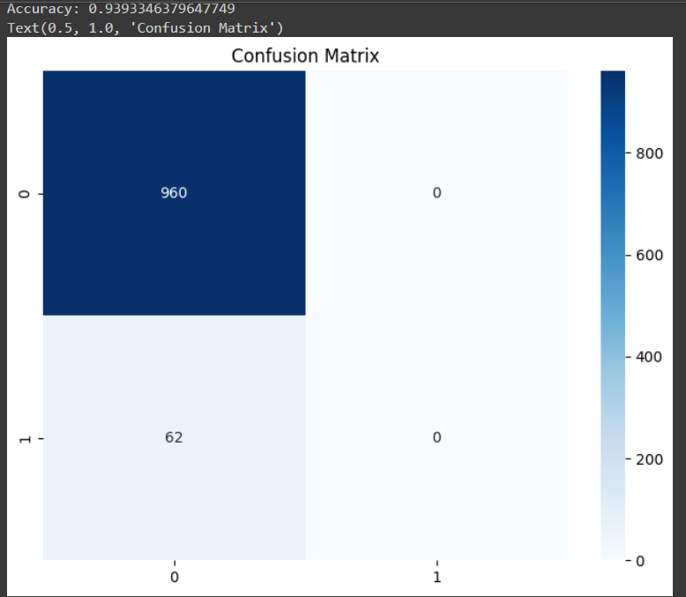
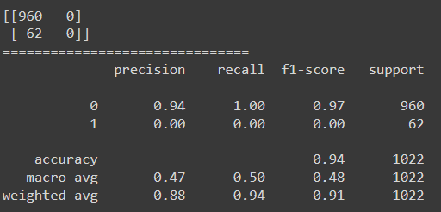
Support Vector Machine (SVM):
Excellent overall performance but struggled to predict stroke cases

Slide 8
Tools:
Tools Used: We implemented the models using Python, utilizing libraries such as scikit-learn and Pandas. All the work was done on Google Colab and Jupyter, ensuring ease of collaboration among team members.
Steps:
Data preprocessing: Handling missing values, and scaling features for SVM and KNN.
Train-test split: We divided the dataset into 80% training and 20% testing data.
Model setup: Each model was configured with default parameters, followed by training and testing.

Slide 9
Discussion
Model Comparison
SVM outperformed the other models in terms of accuracy and F1-score. This can be attributed to SVM’s strength in handling complex, high-dimensional data. KNN also performed well but took longer to compute as it calculates the distance between each point. The Decision Tree, while easy to interpret, had slightly lower performance due to overfitting on the training data.
Challenge :
Handling missing values in the dataset.
Computational cost for KNN, especially with large datasets.
Tuning hyperparameters for optimal performance.

Slide 10
Results:
We compared three algorithms for stroke prediction: SVM, Decision Tree, and KNN. SVM performed the best between them, providing excellent accuracy because of it's ability to handle complicated data.. KNN also provided good results but was slower and more computationally expensive. Decision Tree , On the other hand was easy to understand but struggled with overfitting, leading to lower accuracy. Overall, SVM turned out to be the best model overall for this job.

Slide 11
GITHUB
Code and Dataset Line
https://github.com/murpanik/Stroke-Prediction-using-Machine-Learning/blob/main/README.md
Dataset Source
https://www.kaggle.com/code/rishabh057/healthcare-dataset-stroke-data/input

